Slide 1



AceNgage
Dec’22 Performance Awards
AceNgage
June’23
Performance Awards

Slide 2

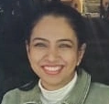


ACE PERFORMER
Consistency is her middle name! Chaya has rocked her KRA’s with ease again this month.
No number is too big or too small for this Wonder Woman ! A star performer with immense focus and determination to be the best – Chaya has achieved these numbers every month keeping her quality and controllable targets too in mind.
Having you on the team is a huge inspiration for everyone else. Your cheerfulness and positivity is also so good to see.
It has been a pleasure to work with you, and we are looking forward to seeing what the future holds for you.
CHAYA RAMESH
Digital Certificate and
Gift voucher

Slide 3
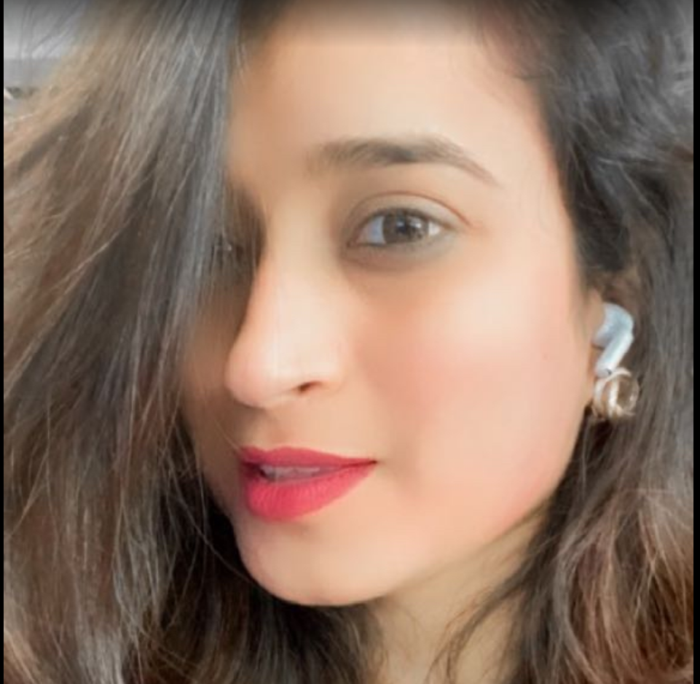
QUALITY PERFORMER
Hemani is an active, enthusiastic, and passionate team member in Exit.
Highly self-motivated to achieve her monthly numbers, she needs no follow up and no reminders.
Her keen participation on client calls, willingness to volunteer for test projects and assignments and just be a cheerleader for her team mates is what makes her so special!
It’s great to have you as a part of the team and we wish you every success in future!
Quality - 83%
HEMANI SHAH
Digital Certificate and
Gift voucher

Slide 4
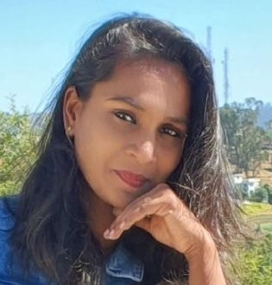
QUALITY PERFORMER
She is a stalwart in CE and Carelon, demonstrating unwavering strength and a commitment to continuous self-improvement.
She consistently strives to surpass her own accomplishments, serving as a beacon of reliability and is an invaluable asset to the team. Her ability to take ownership , learn from her mistakes and take feedback is very commendable.
Inspite of handling multiple roles and having to work on multiple clients , we are delighted to see Thanuja holding on to her quality standards.
Keep it up Thanuja !
Quality – 82%
LAKSHMI THANUJA
Digital Certificate and
Gift voucher

Slide 5
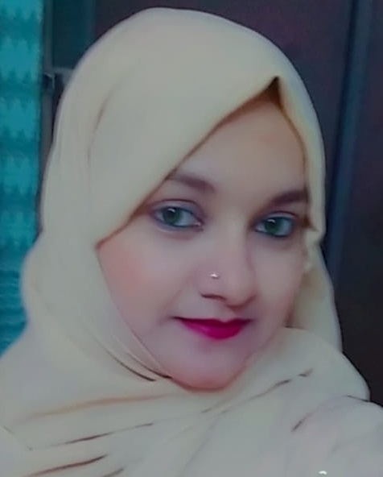
MOST IMPROVED PERFORMER
You have been a valuable member of our Team and we have noticed all the hard work you have put in.
We highly appreciate the fact that you need no follow ups and all your work is up to date and above par!
Keep it up! We wish you goodluck for the upcoming month!
Super proud of U!
SYEDA ASHRAF
Digital Certificate and
Gift voucher

Slide 6
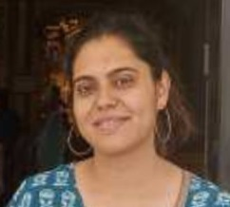
MOST IMPROVED PERFORMER
Rashu is one such employee who inspires all of us to push harder and work diligently..
She has always helped her fellow team mates and has been very patient with everything.
She has managed to achieve all her KRAs throughout and we wish to see her achieving great success in near future as well.
Well done Rashu ! proud of you!
RASHU SINGH
Digital Certificate and
Gift voucher

Slide 7
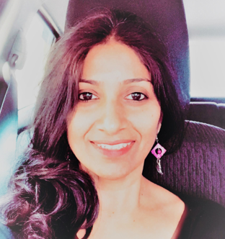
MOST IMPROVED PERFORMER
The calm and mature member of the CITI Team. Elizabeth handles her client spocs with ease and is a pillar of support for her SME.
Her growth and improvement is truly commendable! Her willingness to learn and adapt is a testament to her commitment and enthusiasm to work.
It is a pleasure to witness her excelling in all that she takes on.
A true asset to the team! Keep up the excellent work!
ELIZABETH SAM
Digital Certificate and
Gift voucher

Slide 8
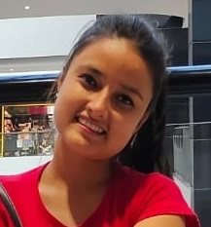
PAT ON THE BACK
A consistent performer in the team, your efforts and hardwork is highly appreciated. Being open to feedback and change is an amazing attribute to have.
Appreciate the fact that you worked sincerely on the feedback and ensured you adhered to the standards set. The team has benefited from your contributions to it.
Your dedication and commitment has paid off.
Keep shining the way you do always!
ANISHA REGMI
Digital Certificate and
Gift voucher

Slide 9
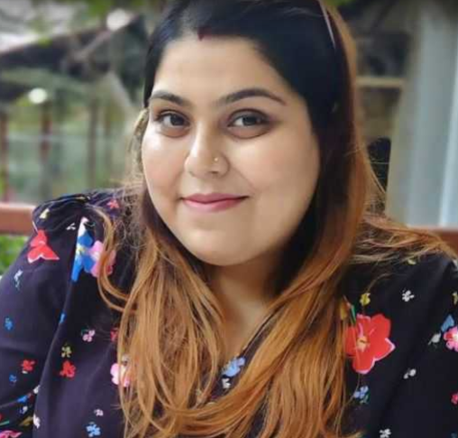
PAT ON THE BACK
Kanwagi consistently demonstrates an exemplary level of professionalism and an impeccable work ethic that has not gone unnoticed.
She helped us with TCL scheduling, Cargill interviews along with doing her part of an Engagement Specialist! She always goes above and beyond her responsibilities, taking on additional projects and offering support to the team whenever needed.
Her outstanding performance serves as an inspiration to us all, and we look forward to witnessing her continued success at AceNgage.
KANWAGI KAUSHIK
Digital Certificate and
Gift voucher

Slide 10
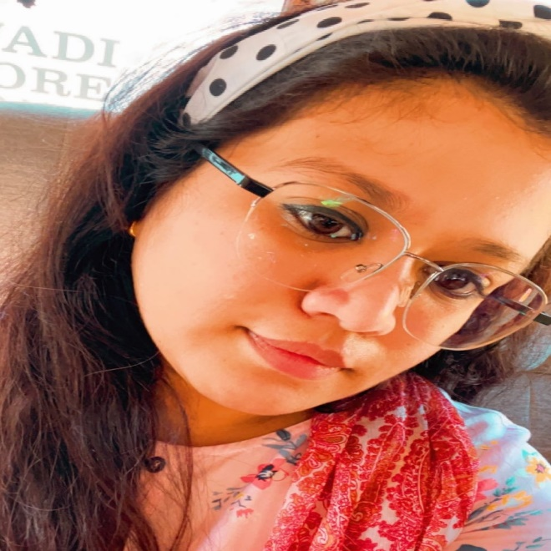
PAT ON THE BACK
People make the difference. And one of those people is you. Thank you for making a difference in our Team.
Your excellence and brilliance have always made for a stunning performance at work.
We are delighted that you are a shining star already in the team!
You have done the highest number of interviews for the month!
NIDA PARVEEN
Digital Certificate and
Gift voucher

Slide 11
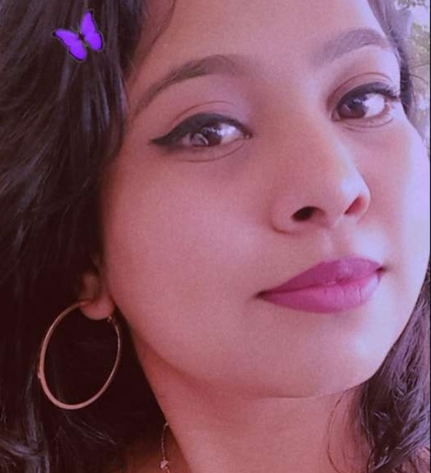
PAT ON THE BACK
Your dedication and commitment to your role has not gone unnoticed, and we are truly impressed by your efforts.
Your proactive approach and willingness to go the extra mile have made a significant impact on our team's success. The way you stepped in to handle the client in your SMEs absence was very much appreciated.
The organization is happy to have received our assistance in preparing weekly reports along with completing your daily tasks.
You are an invaluable asset to the team !
SNEHA R H
Digital Certificate and
Gift voucher

Slide 12
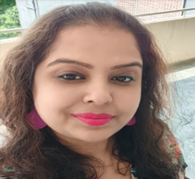
PAT ON THE BACK
A dedicated counsellors who takes responsibility and is accountable for everything she does.
Lovely to see that she geared up to meet all the 4 parameters.
As a counsellor she’s very cooperative and strives hard to achieve her numbers.
Preeti always gives her Best.
Proud to have you in our team.
PREETI G
Digital Certificate and
Gift voucher

Slide 13
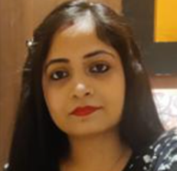
PAT ON THE BACK
She stepped up and took on a new client with utmost dedication and skill! Today , because of her persistence and hardwork, the client is in a happier place.
Her tireless efforts and commitment to excellence are impressive!
Her work ethic and professionalism serve as a model for the rest of the team.
Thank you for going above and beyond.
You are an inspiration to all!
AKANKSHA
Digital Certificate and
Gift voucher

Slide 14
WINNERS LIST
CHAYA RAMESH
HEMANI SHAH
LAKSHMI THANUJA
SYEDA ASHRAF
RASHU SINGH
ELIZABETH SAM
ANISHA REGMI
KANWAGI KAUSHIK
NIDA PARVEEN
SNEHA R H
PREETI G
AKANKSHA

Slide 15
Well Done to the winners… – …Good Luck for July’23

